Slide 1
EVALUATING SUPERVISED and UNSUPERVISED Learning Classifiers to Predict Student Success in School
Notes:
Good day, ladies and gentlemen. I'm going to present the process of supervised learning classifiers to predict students’ success in a course during a school year based on students’ social, and demographic data.

Slide 2

Topic
This study intends to model student achievement in secondary education using classification techniques to evaluate whether a good predictive accuracy could be achieved based on student grades, demographic, and social-related features.
The aim is to identify the key variables that affect students' educational success/failure, to better administer school resources, and to target the most vulnerable students based on their demographic and social characteristics.

Slide 3

The DATASET
The dataset is Student Performance, donated by Pablo Cortez (2014), and published in UC Irvine Machine Learning Repository.
The dataset includes the student grades, demographic, social, and school-related features for Portuguese language courses in two Portuguese schools. The data was collected by using school reports and questionnaires.
The dataset contains 30 features and 649 instances.
Source: UC Irvine Machine Learning Repository
Link: https://archive.ics.uci.edu/dataset/320/student+performance

Slide 4
Knowledge discovery process
Exploring the dataset
Pre-processing the data
(Cleaning & Transformation)
Exploratory Analysis
(Identifying pre-processing and modeling methods)
Evaluating the model
Modeling Process
(Testing Different Model Setups)
Missing Values
Duplicated Values
Features Reduction
Variable Transformation
Data Distribution
Data Imbalance
Correlation Analysis
Features Importance
Supervised Learning:
Decision Tree
Random Forest
AdaBoost
Support Vector Machine
Unsupervised Learning:
NMF
K-Means Clustering
The best modeling setup

Slide 5
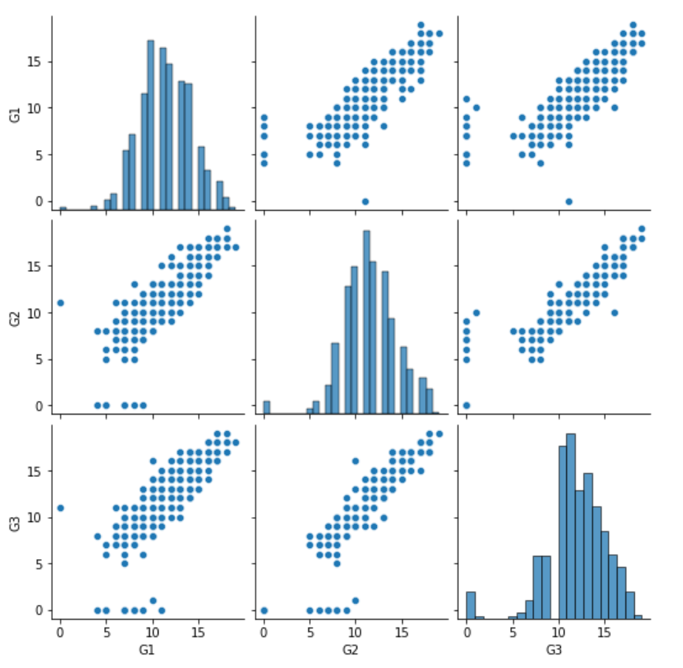
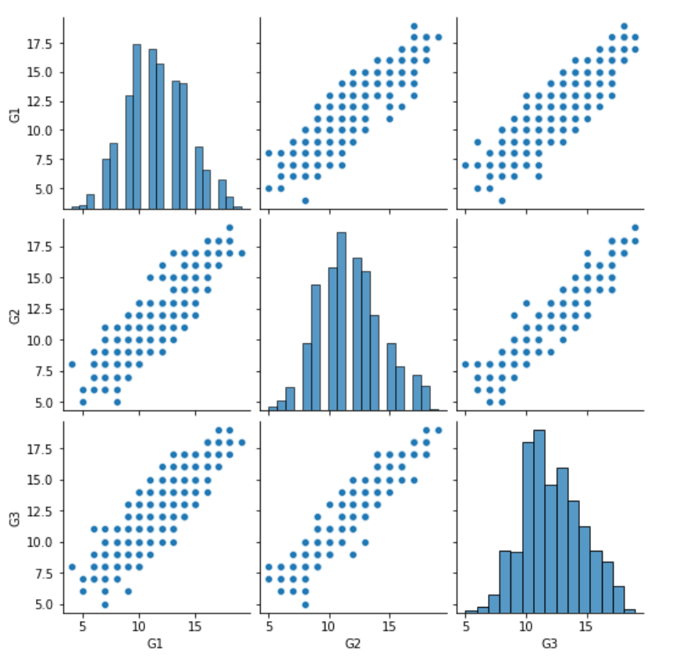
Data Pre-processing
Highlights:
No missing values.
No duplicated values.
Outliers were identified and removed using EllipticEnvelope with a 3% contamination.
Dropped two feature variables without predicting power for student success.
Dropped two target variables related to first-term and second-term grades.
Transformed nominal variables into multiple binary columns.
The target variable (G3) converted into a pass/fail (binary) class

Slide 6
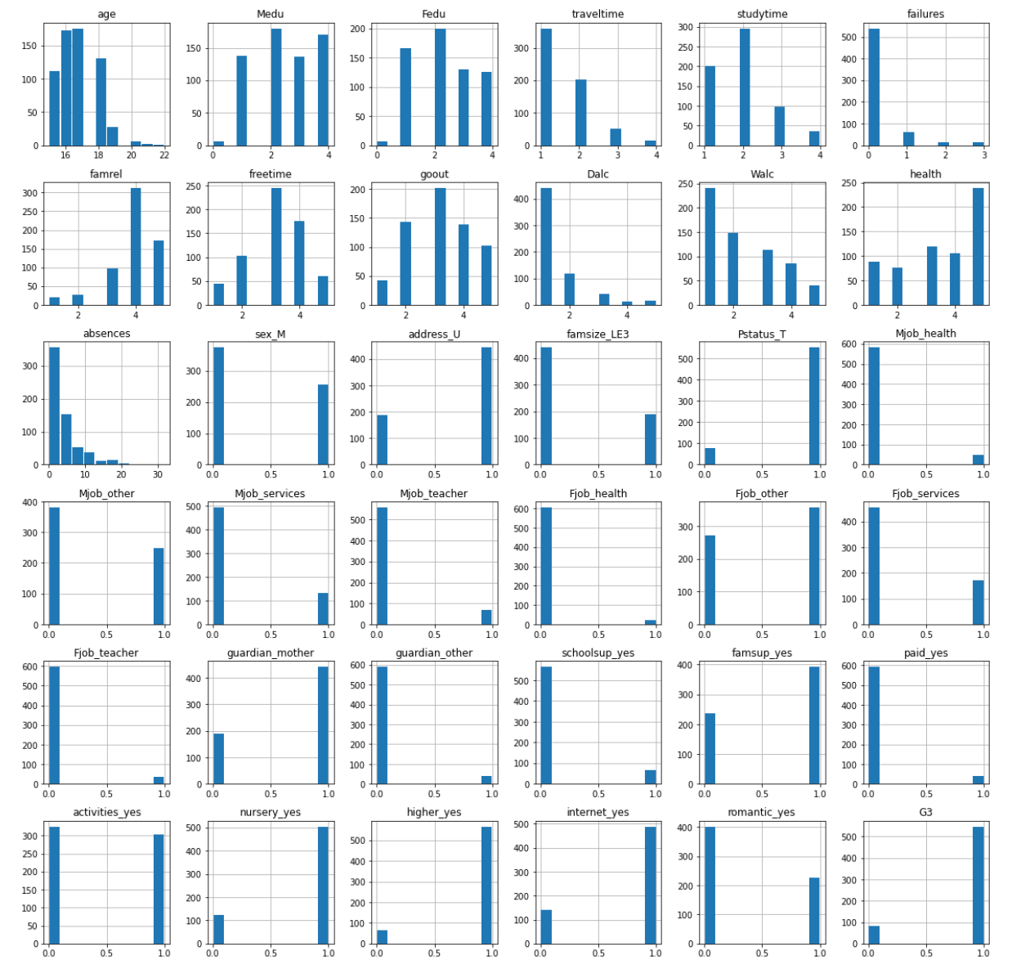
Exploratory analysis
Highlights:
Presence of Class Imbalance.
Correlated Analysis, most correlated features:
Past failures [failures]
Pursuing higher education [higher]
Mother education [Medu]
Number of absences from school [absences]
Weekly study time [studytime]
Feature Importance, top 5 important features:
Mother education [Medu]
Father education [Fedu]
Number of absences from school [absences]
Past failures [failures]
Weekly study time [studytime]

Slide 7
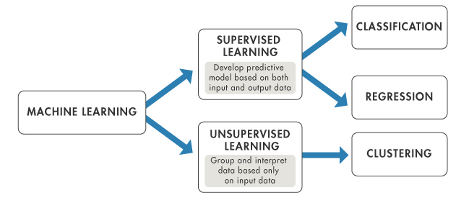
Modeling process
Highlights:
Two learning methods
Supervised Binary Classifiers
Decision Tree (DT)
Random Forest (RF)
AdaBoost (AB)
Support Vector Machines (SVM)
Unsupervised Binary Classifiers
Non-Negative Matrix Factorization (NMF)
K-Means Clustering

Slide 8
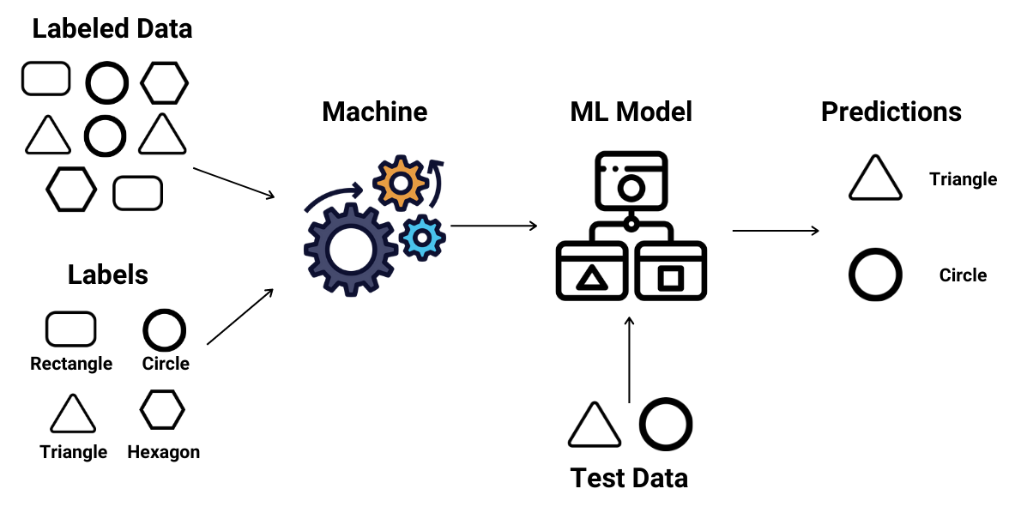
Supervised learning model
Highlights:
Setting up a pipeline with the following steps:
Standardization [StandardScaler, Normalizer]
Oversampling (RandomOverSampler, SMOTE)
Feature Selection (PCA, chi2, MI)
Cross Validation (Kfold, StratifiedKfold, ShuffleSplit)
Classification (DT, RF, AB, SVC)
612 different model setups were evaluated using cross-validation and 3 scoring metrics: accuracy, precision, and au_roc.
Best Model Setup, a Random Forest Classifier, achieved 86.3% accuracy, 87.6% precision, and 84.3% au_roc average across folds for the training set.

Slide 9
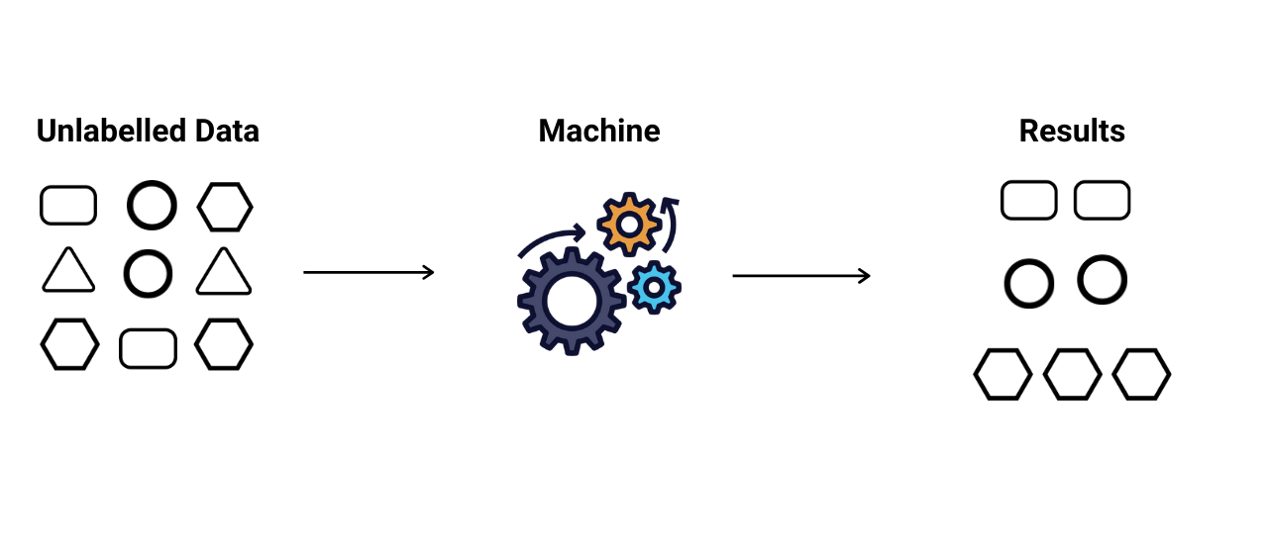
Unsupervised learning model
Highlights:
Setting up two classifiers
Non-Negative Matrix Factorization
K-Means Clustering
With the following steps:
Oversampling (RandomOverSampler, SMOTE)
Hyperparameters Tuning
90 different model setups were evaluated (36 for NMF, and 54 for K-Means).
The Best Model Setup for NMF achieved 68.2% accuracy, 89.8% precision, and 62.2% au_roc average against the training set.
The Best Model Setup for K-Means achieved 72.8% accuracy, 87.25% precision, and 56.45% au_roc average against the training set.

Slide 10
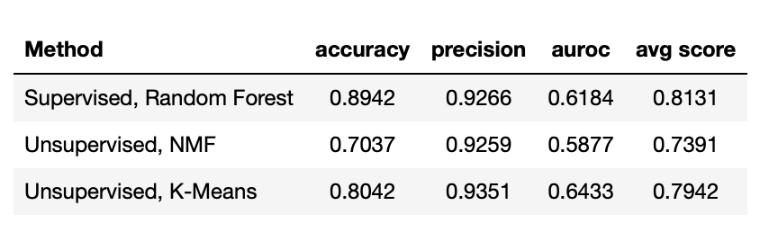
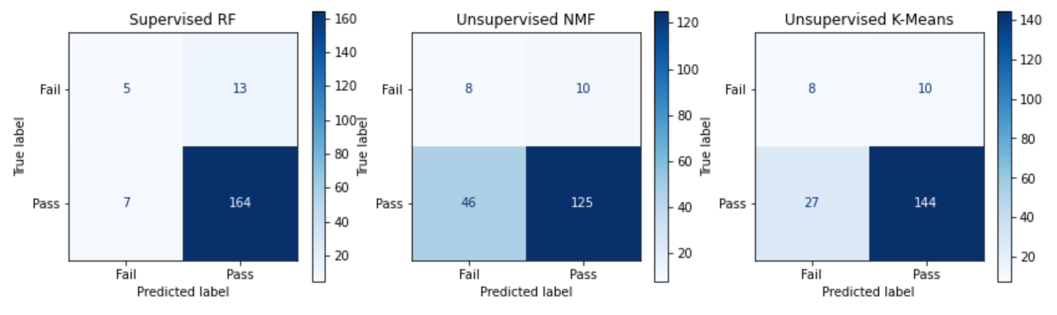
Results Predictive Performance
By Classifier:

Slide 11
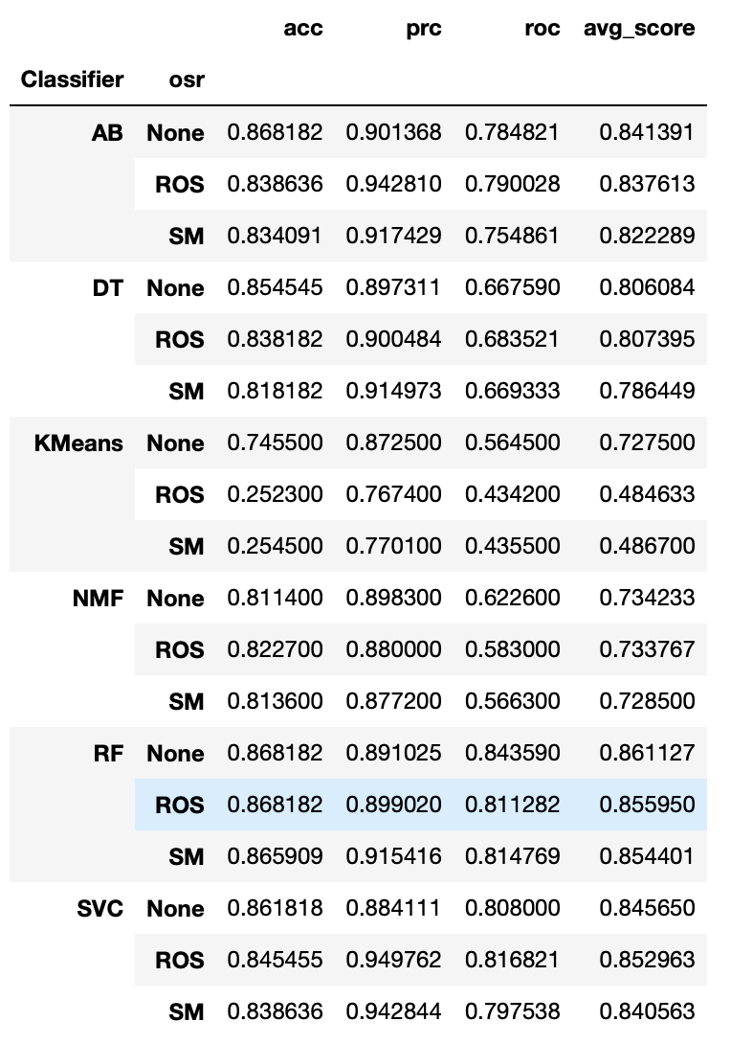
Results Predictive Performance
By Over Sampler:

Slide 12
Conclusions
The results revealed that it is possible to predict student educational success over a school period using students' demographic, social, and other school-related data using supervised and unsupervised learning models with good accuracy and precision. However, more needs to be done to increase the likelihood of the models distinguishing the minority class ‘fail’.
Despite attempts to address class imbalance through oversampling techniques, the models' performance in distinguishing between the majority and minority classes did not show significant improvement. This highlights a limitation in the current predictive models.
Based on what was observed during the data exploration analysis, the most important factors in student educational success are study time, travel time, free time, past failures, family relationships, and parents' education.
Notes:
In conclusion,
Even though,

Slide 13
Thank you

